Slide 1
CAP Test Automation strategy

Slide 2
Old Test Strategy Approach
CAP (Consumer Account Profile) uses Jmeter Tool to test each microservices .
CAP has 4 environment (DEV, QA, EDU and PROD). Each environment had its own hardcoded Jmeter scripts and data . Anytime a new user story is executed, all jmeter scripts needs to be changed manually.
Drawbacks:
  Every new user story needs new testScript added in jmeter file and their respective data validation in the database which is tedious and time consuming and makes the jmeter file lengthy.
  Test data may conflict with the actual users in all environments and make it difficult to validate.
  Existing Test Scripts data may get deleted by other test and it needs to be validated every time when we run the jmeter to have successful execution.
  Retrieve Services always have dependency on respective maintain services, so every time a new user story comes to Retrieve then its respective maintain testScript also needs to be created in the retrieve jmeter files.
  Due to the dependency, the test cases related to new user story may fail even if its respective dependency service is down for any other reason.
  The Property File Reader path & test data are hardcoded which makes it difficult to use the same test Scripts in different environments.
  Multiple database queries are executed manually for each Test Scripts and thus exhausting the database resources and impacting the actual service.
  While testing the entire response json is not compared instead the part of json or specific fields are compared.
  If we run the jmeter for Retrieve services repeatedly then its respective maintain services dependency testScript added in the same jmeter file will also get executed repeatedly and it will log n number of records in our logging tables.

Slide 3
Current Test Strategy - Automation Approach
In order to overcome the drawbacks identified in our earlier approach, we have created a test strategy that will automate majority of our test case and will reduce the developers effort to great extent.
Test Automation Approach Followed:
  Create one Jmeter File per microservice independent of the environment & Same script across all services.
  Create Individual property file for each environment(DEV, QA, EDU and PROD) and property file path is dynamic .
  Same Test Data are used across all environments(DEV, QA, EDU and PROD).
  Each test case will have its own test data maintained in the database instead of hardcoding in jmeter file.
  Test Data will not conflict with the existing users, since test users have unique guid and created with unique email id (jmeterTest@gmail.com)
  Every time we don’t have to validate for the availability of the test data since its maintained in database with respective permission levels.
  Dependency services test scripts data are also populated in same table specifying the dependency service name.
  Dependency Jmeter Scrips thread group are included in the parent services and executed at once and will be available always and will rerun if any changes comes up.
  The possibility of test cases failing due to dependency services unavailability is avoided.
  Each micro services test cases will run independently thus avoiding dependency services logging in database even if we run repeatedly.
  and hence same jmeter can be used across all environment.
  Test data are fetched from the database initially and will run all the test case automatically by jmeter scripts and database queries are executed only once throughout the testing.
  Multiple database calls are avoided.
  Jmeter scripts are integrated with CI/CD process to ensure testing of each microservice after deployment by triggering Jenkin Jobs.
  All the CAP micro services can be tested at once shot for specific releases.

Slide 4
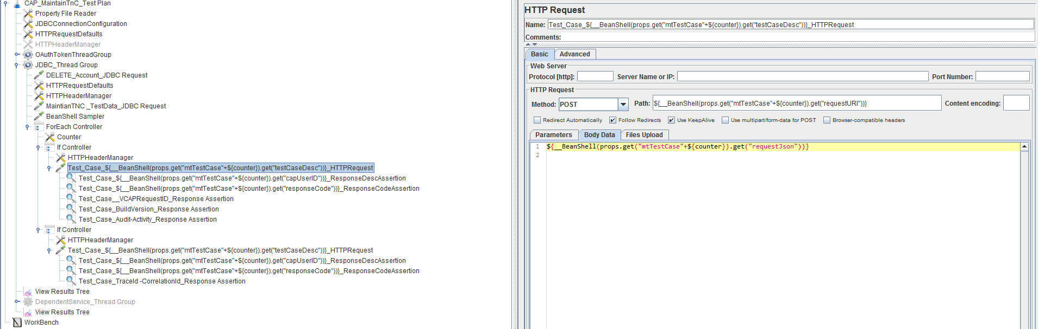
Jmeter File
Individual Jmeter File & Same Jmeter Scripts across all services:
→ Each micro services will have its own Jmeter file and it would be same across all environment.
→ All the micro services will have the same Test Scripts inside the Jmeter File with different service name populated from the property file.
→ If a new user story comes then we don’t have to add or change any testScript in the jmeter file, we just need to populate the data in the database and it will work automatically.

Slide 5
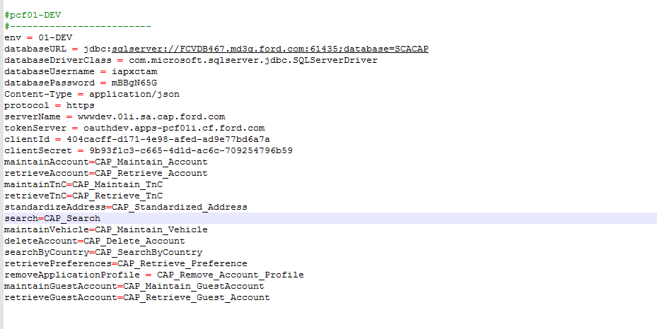
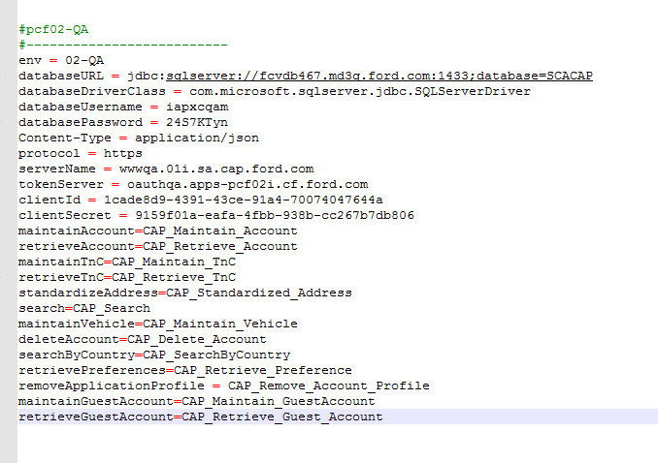
Property File Reader
  Individual property file for each environment.
  Each environment will have different property file with respective sever name ,oAuth credentials ,database details and service name.
  DEV: QA:
  Property files path are set dynamically by Jenkin Jobs

Slide 6
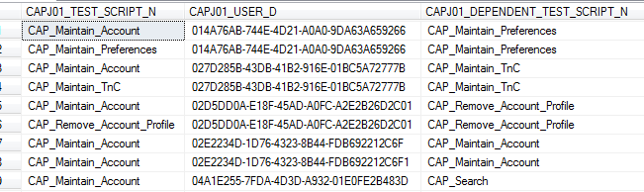
Test Data
Test Data :
→Test Data for all micro services are maintained in the [MCAPJ01_AUTOMATE_TEST_SCRIPT] table and Jmeter scripts pull those data from the database based on the services and perform the testing.
→ When a new user story is developed then the test data related to that are added in to the J01 table and no changes needs to be done on Jmeter scripts, when code is developed and pushed to git then jmeter will run automatically.
→For each test cases we create an individual entry under this table with unique CAPUserID([CAPJ01_USER_D],TestScriptName [CAPJ01_TEST_SCRIPT_N] and dependency test script name [CAPJ01_DEPENDENT_TEST_SCRIPT_N] as primary key.
  → Test data are isolated from actual data by populating the email id with combination of JmeterTest@gmail.com for the respective test CapUserId.

Slide 7
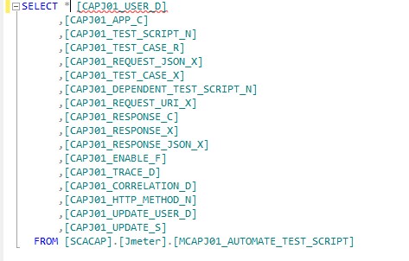
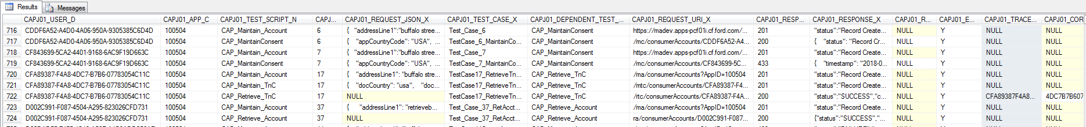
Table Design:
Table Columns:
→The below listed are the columns under the J01 table
→Columns / data are populated based on each test case requirement .Attached the detailed column explanation.

Slide 8
Table - Dependency Data:
Dependency Data Population:
→If a test case has a dependency on other services then that dependency data needs to be executed to run this test case successfully.
→When we insert a test case record for Retrieve Account service success scenario then we need to have an account existing in our P01 User table.
→So every successful retrieval of account happens only if a data already exists in account table.So when creating test data we need to add their dependency test data as below.
→Similarly for RetrieveTnC, we have dependency on MaintainTnC and Maintain Account.

Slide 9
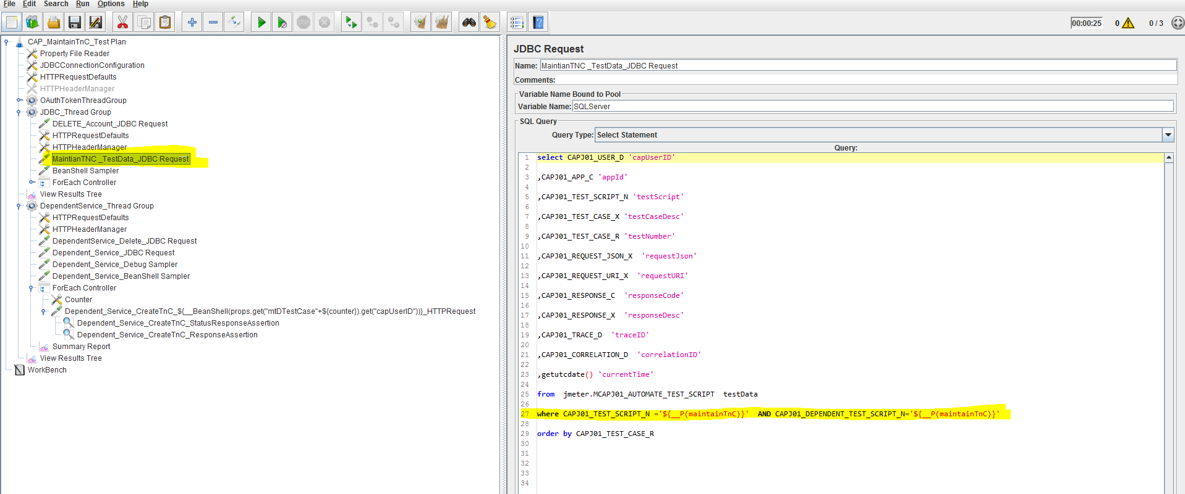
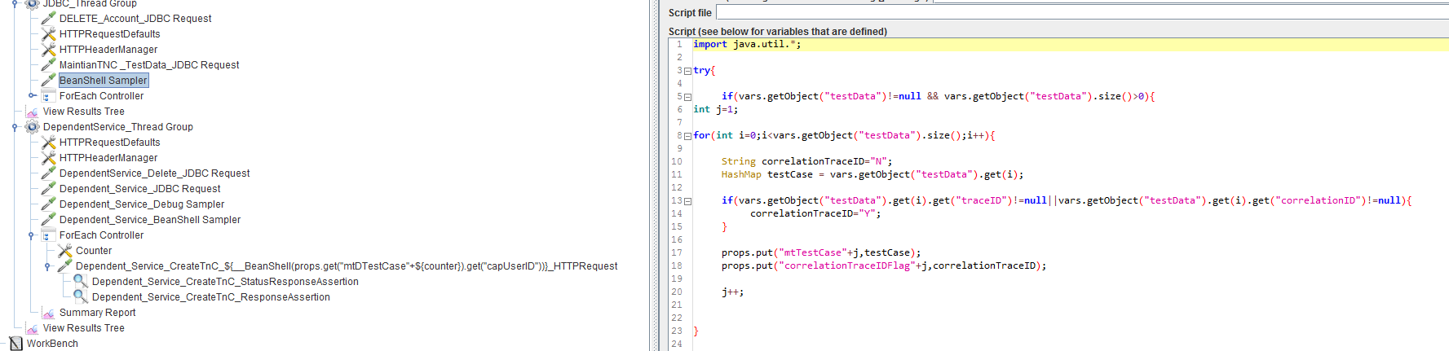
Jmeter Scripts
Jmeter Scripts :
→ Jmeter Test scripts are same across all services and only change would be on the service name that is pulled from property file dynamically.
→ Initially we fetch the data from the database, based on the service name it will pull the data and store as object using bean sampler.
Bean Shell Sampler

Slide 10
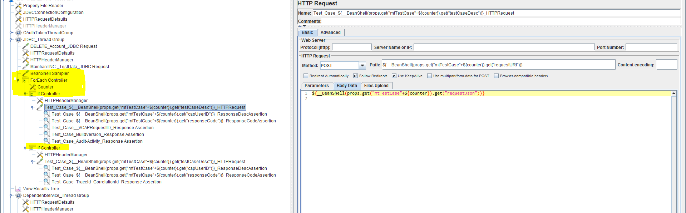
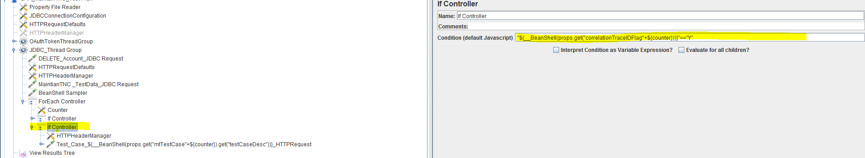
Jmeter Scripts (Cont..)
Jmeter Scripts :
→Bean Shell Sampler will take the entire test data records and store it in a object and its passed to test scripts .
→A for each loop is used to iterate same scripts and counter is used to increment and data is populated from bean shell sampler.
→For each loop has two “if controller” and it executes based on the conditions.
→ There are two test script sections because there are some test case where we need to externally populate the header variables (correlation, trace-id etc.),so for executing those we have separated the scripts using an if controller variable.

Slide 11
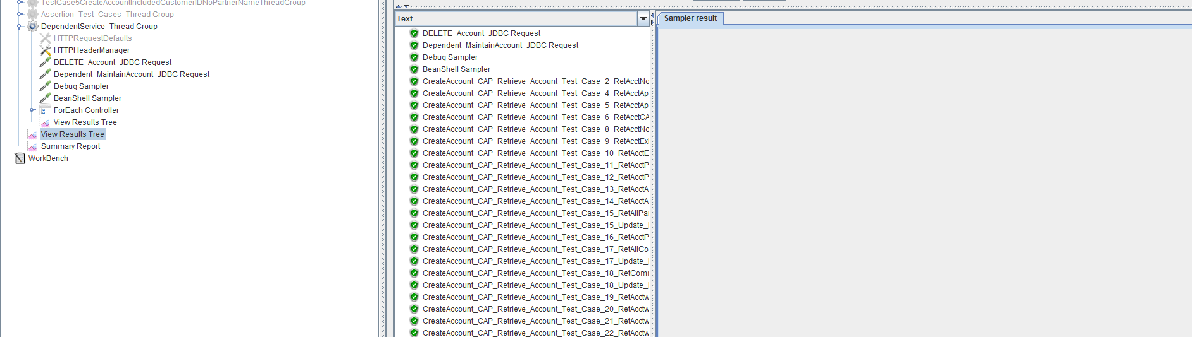
Jmeter Scripts (Cont..)
→In order to run the jmeter and execute the test scripts repetedly, every time we needs to delete the data once those are created by jmeter using jdbc delete scripts.
Dependency Scripts :
→ If there is any dependency(Retrieve have dependency on Maintain Services) then the dependency thread groups are created in Maintain services.

Slide 12
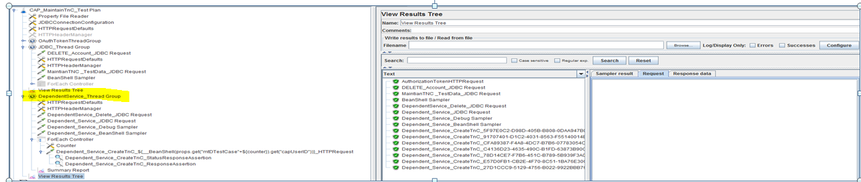
Jmeter Dependency Scripts(Cont..)
Dependency Scripts :
→Prerequisite for Retrieve TnC to run is the terms and conditions needs to be added in the TnC table which is accomplished through maintain tnc services ,so dependency for the retrieve TnC is created in MaintainTnC and its executed only once during the new insertion of records in the J01 table.
  →All terms and conditions needs to be linked with a user ,so we need a user in the user table. So that respective dependency is created in the Maintain Account table and again that’s executed only once during the data insertion under J01.

Slide 13
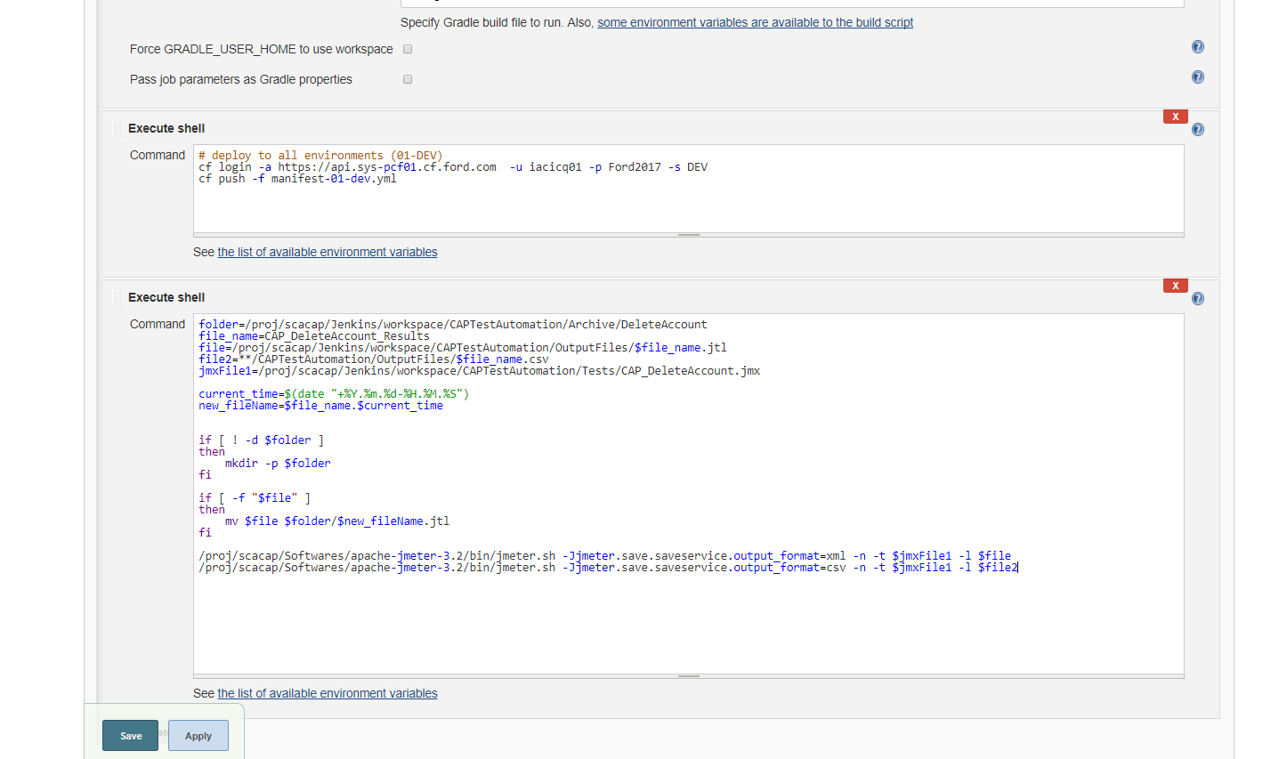
Jenkin Jobs
Create a Jenkins job to execute the test scripts for each environment
Save the summary report name with attached environment and TimeStamp. Eg: RetrieveAccount_Summary_02-DEV_20171204
Jenkins should trigger the execution of the particular Jmeter script as when the microservices is deployed

Slide 14
Future Enhancement:
Currently all the test cases are not automated ,the test cases where ever we needed manual deletion or alteration of data in multiple tables are ignored.
Database assertion is not done, current automation rely on services and its output. So database assertion part needs to be developed.
Permission to the database should be refined and deletion of data needs to be avoided.

Slide 15
Thank you …
Ship faster, reduce risks, grow your business

